Slide 1

RxJS 7.x with React JS (Observable)

Slide 2
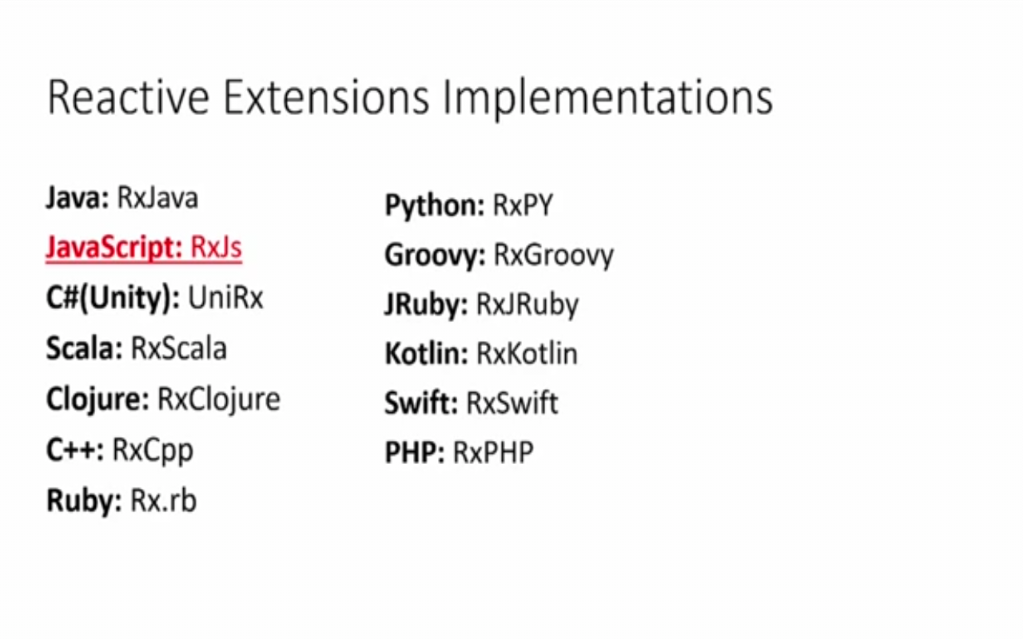
Reactive eXtensions (RX)
What is Reactive Programming?
Programming paradigm that works with asynchronous data streams.

Slide 3


RxJS
Reactive programming is a declarative programming paradigm that deals with the flow of data in “streams” and with its propagation and changes.
RxJS, a library for reactive programming in JavaScript, has a concept of observables, which are streams of data that an observer can subscribe to,
and this observer is delivered data over time.
An observer of an observable is an object with three functions: next, error, and complete.

Slide 4
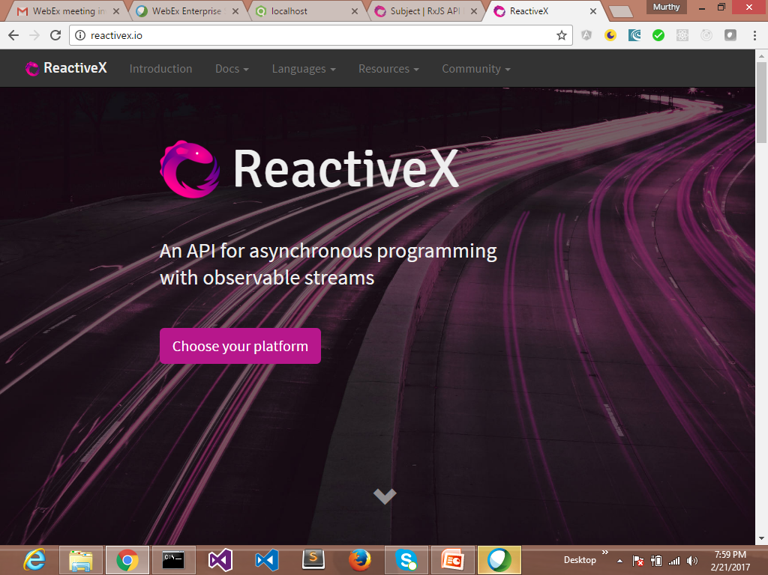
Reactivex.io/rxjs

Slide 5
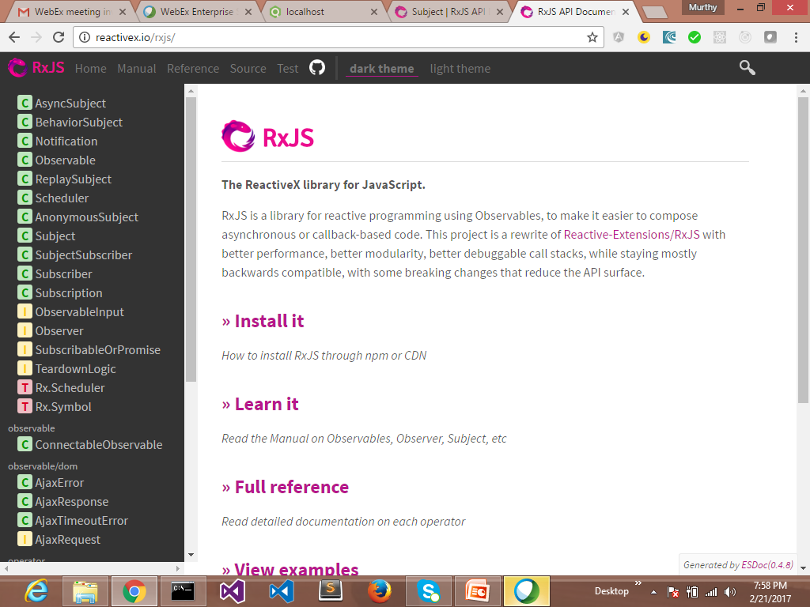
Reactivex.io/rxjs

Slide 6
Observable
A Stream?
- A Sequence of ongoing events ordered in time
- Emits a value , error and complete signal
Indicates an error
X
Indicating event with value
(click)
Indicates
Stream has
completed

Slide 7
Stream
Streams are a sequence of values over time.
For example a number that goes up by 1 every second might have a stream that looks like [0,1,2,3,4]
Another stream might be a sequence of x and y positions of mouse click events, like so:
[(12,34), (345,22), (1,993)]
Or JSON array: [
{ "name": “Sri" }, { "name": “Murthy" },
{ "name": “Raju" }, { "name": "Asim" }
]

Slide 8
Observable
rxjs/webSocket: Contains the web socket subject implementation.
import { webSocket } from 'rxjs/webSocket';
rxjs/ajax: Contains the Rx ajax implementation.
import { ajax } from 'rxjs/ajax';
rxjs/testing: Contains the testing utilities for RxJS
import { TestScheduler } from 'rxjs/testing';
.

Slide 9
Observable
Observables is a new primitive type which acts as a blueprint to create streams, subscribe to them, react to new values, and combine streams together to build new ones.
RxJS stands for *R*eactive E*x*tensions for *J*ava*S*cript, and its a library that gives us an implementation of Observables for JavaScript

Slide 10
RXJS
Reactive Extensions for JavaScript (RxJS) is a reactive streams library that allows to work with asynchronous data streams with Observable.
RxJS can be used both in the browser or in the server-side using Node.js.
Angular prefers Observables instead of Java script Promises for Http and Form data.
Observable
A sequence of items that arrive asynchronously over time.

Slide 11
Observable
let obs = Rx.Observable
.interval(1000)
.map((v) => Math.random())
.take(3);
obs.subscribe(value => console.log("Subscriber: " + value));
Output:
Subscriber: 0.14669644453458597
Subscriber: 0.5896970672476727
Subscriber: 0.09818169196770854
let observable= http.get(“stream.com”)
Observable.toPromise(resolve,reject)
observable.subscribe(…….)
Notes:
Observables are treated like arrays. Each value over time is one item in the array. This allows us to use array like methods called operators on our Observable such as map, flatmap, reduce, ect. In our service we will be using a special type of an Observable called a BehaviorSubject. A BehaviorSubject allows us to push and pull values to the underlying Observable. We will see how this will help us construct our service.
In Angular we use RxJS a polyfill/util library for the proposed Observables primitive in the next new version JavaScript. RxJS version 5 is a peer dependency with Angular. A slim Observable is used in Angular 2+ core. The slim Observable does not have many of the useful operators that makes RxJS so productive. The Observable in Angular is slim to keep the byte site of the library down. To use extra operators we import them like so: import 'rxjs/add/operator/map';.
In our example we will have a TodosService. Our todos service will have basic CRUD operations and a Observable stream to subscribe to. This example we will use a REST based API but it could be converted to a real-time socket based API with little effort. Next lets take a look at a the constructor of our service.

Slide 12


Observer & observables
Observer Monitors observable
Observable Does something
//https://www.learnrxjs.io/learn-rxjs/operators
Notes:
//https://www.learnrxjs.io/learn-rxjs/operators

Slide 13
Observer & observables
Yum!

Slide 14
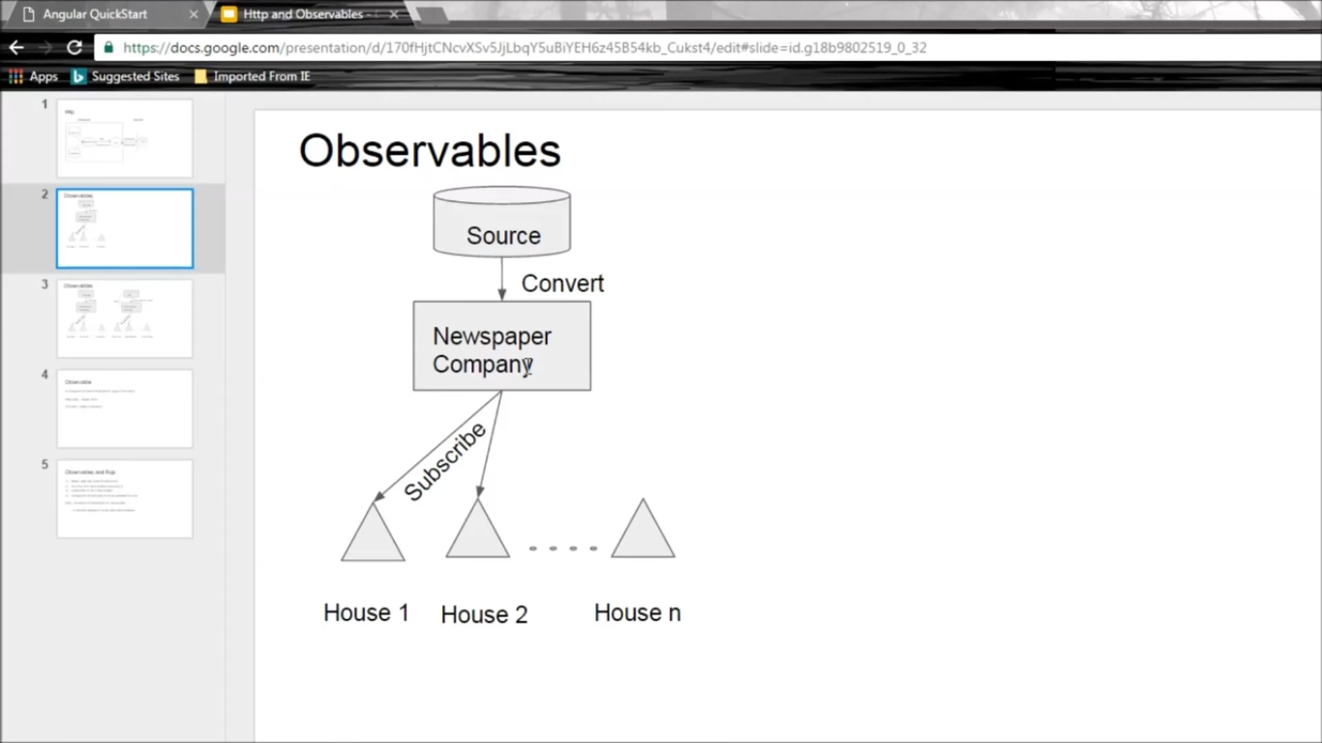

Slide 15
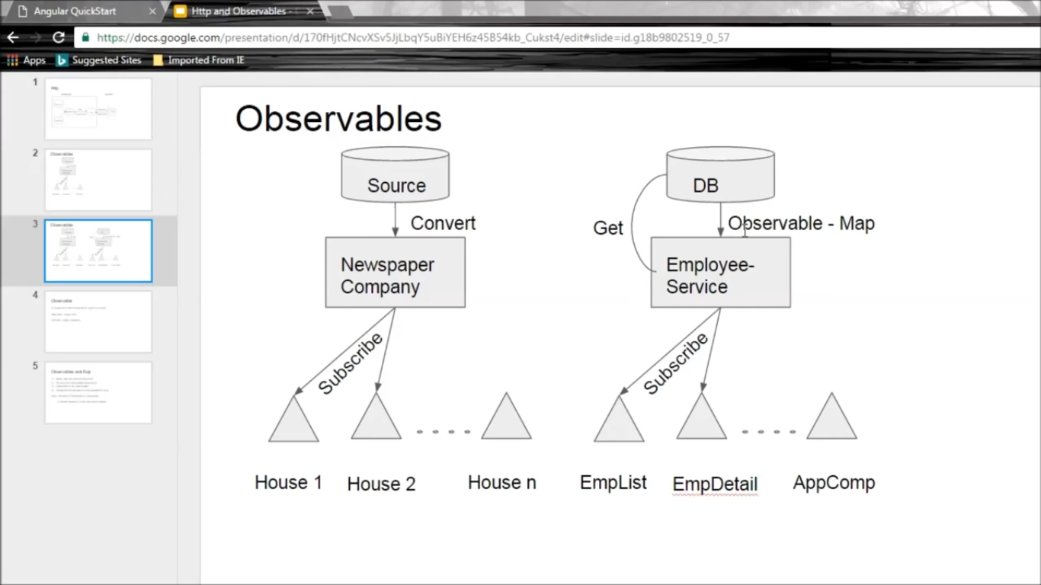

Slide 16
RXJS
Observable Operators
creation, conversion, combine, functional, mathematical, time, exceptions, miscellaneous, selection and primitives.
merge @, concat @, defer, do, map @, flatMapLatest, fromPromise, fromEvent, takeUntil @, throttle, delay @, empty, catch, if, timer, filter, zip @.
var obs = Rx.Observable.interval(500)
.take(5)
.do(i => console.log(i) );
obs.subscribe();

Slide 17
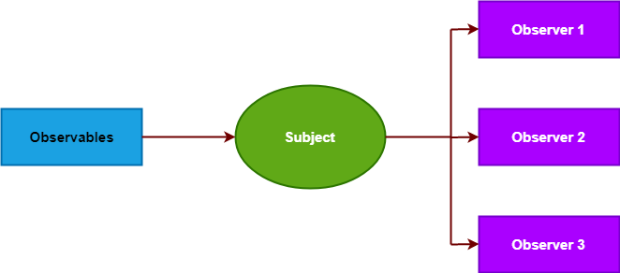
Observer & observables

Slide 18
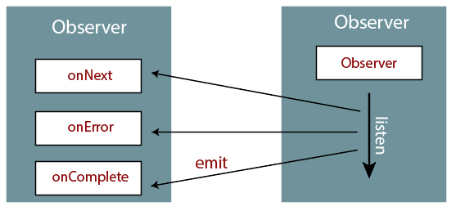
Observer & observables

Slide 19
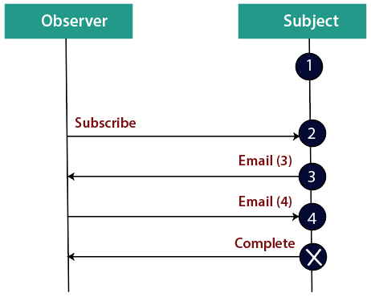
Creating Observables

Slide 20
RXJS
Pass in observer when calling subscribe or by passing onNext, onError and onCompleted callbacks. These are their behaviours:
onNext, called for each element in the observable sequence.
onError, called only once in case of an error.
onCompleted, called only once when the stream finishes.

Slide 21
RXJS
var observer = rx.Observer.create(
function onNext(result){
console.log(result);
},
function onError(err){
console.log(err);
},
function onCompleted(){
console.log('Completed'); });
observable.subscribe(observer);

